Slide 1
An Introduction to Parallel Programming
Peter Pacheco
Chapter 6
Parallel Program Development
Copyright © 2010, Elsevier Inc. All rights Reserved
Notes:
The University of Adelaide, School of Computer Science
Chapter 2 — Instructions: Language of the Computer

Slide 2
Roadmap
# Chapter Subtitle
Solving non-trivial problems.
The n-body problem.
The traveling salesman problem.
Applying Foster’s methodology.
Starting from scratch on algorithms that have no serial analog.
Copyright © 2010, Elsevier Inc. All rights Reserved
Notes:
The University of Adelaide, School of Computer Science
Chapter 2 — Instructions: Language of the Computer

Slide 3


TWO N-BODY SOLVERS
Copyright © 2010, Elsevier Inc. All rights Reserved

Slide 4
The n-body problem
Find the positions and velocities of a collection of interacting particles over a period of time.
An n-body solver is a program that finds the solution to an n-body problem by simulating the behavior of the particles.
Copyright © 2010, Elsevier Inc. All rights Reserved

Slide 5

Position_{time 0}
Position_{time x}
mass
N-body solver
Velocity_{time x}
Velocity_{time 0}
Copyright © 2010, Elsevier Inc. All rights Reserved

Slide 6
Simulating motion of planets
Determine the positions and velocities:
  Newton’s second law of motion.
  Newton’s law of universal gravitation.
Copyright © 2010, Elsevier Inc. All rights Reserved

Slide 7

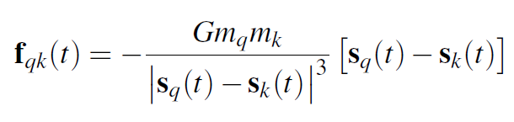

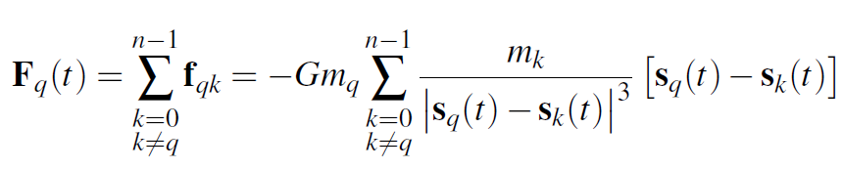
Copyright © 2010, Elsevier Inc. All rights Reserved

Slide 8

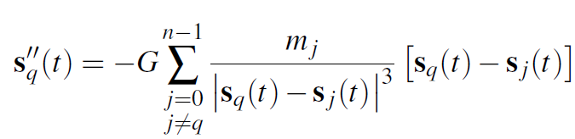

Copyright © 2010, Elsevier Inc. All rights Reserved

Slide 9
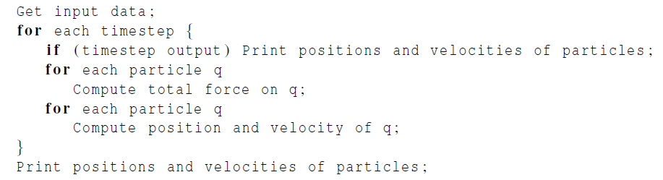
Serial pseudo-code
Copyright © 2010, Elsevier Inc. All rights Reserved

Slide 10
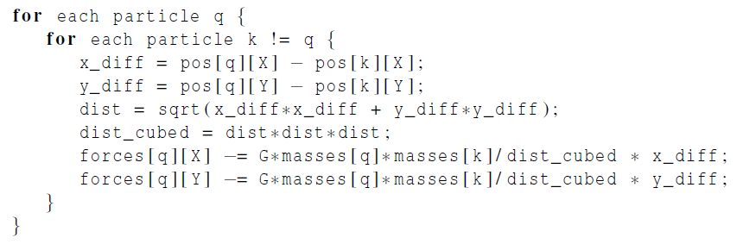
Computation of the forces
Copyright © 2010, Elsevier Inc. All rights Reserved

Slide 11
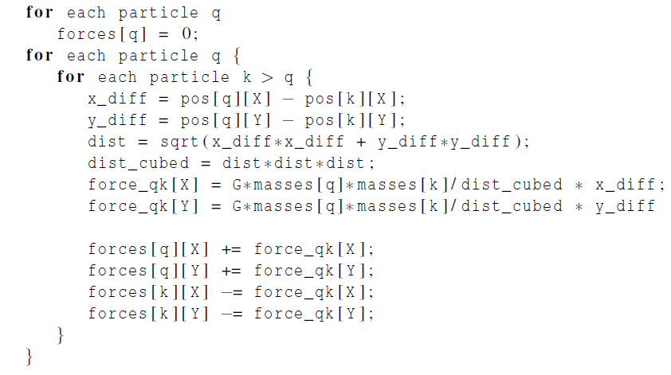
A Reduced Algorithm for Computing N-Body Forces
Copyright © 2010, Elsevier Inc. All rights Reserved

Slide 12
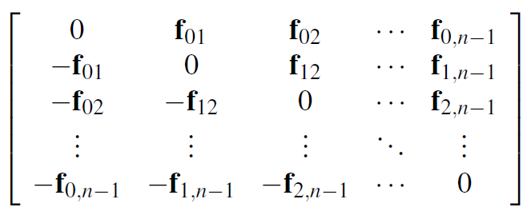
The individual forces
Copyright © 2010, Elsevier Inc. All rights Reserved

Slide 13
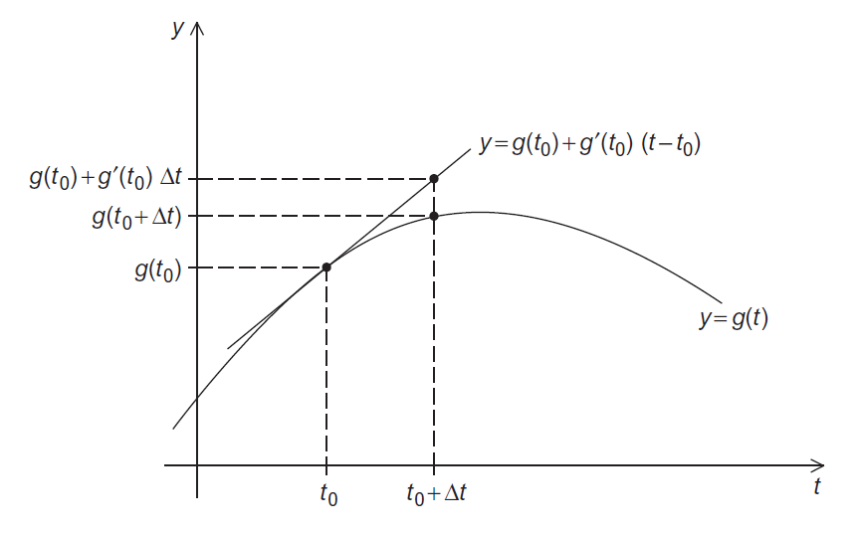
Using the Tangent Line to Approximate a Function
Copyright © 2010, Elsevier Inc. All rights Reserved

Slide 14
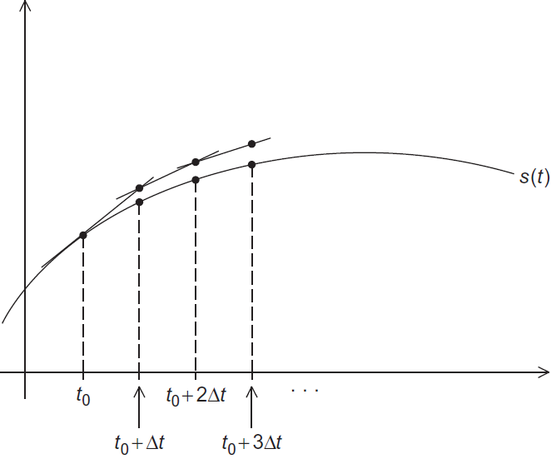
Euler’s Method
Copyright © 2010, Elsevier Inc. All rights Reserved

Slide 15
Parallelizing the N-Body Solvers
Apply Foster’s methodology.
Initially, we want a lot of tasks.
Start by making our tasks the computations of the positions, the velocities, and the total forces at each timestep.
Copyright © 2010, Elsevier Inc. All rights Reserved

Slide 16
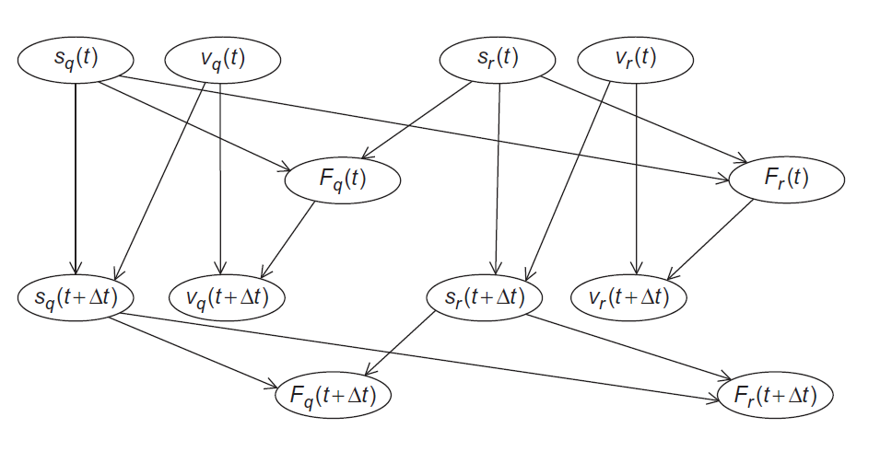
Communications Among Tasks in the Basic N-Body Solver
Copyright © 2010, Elsevier Inc. All rights Reserved

Slide 17
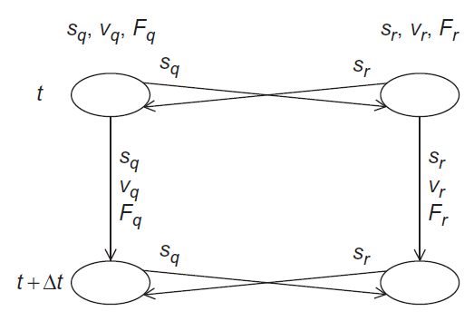
Communications Among Agglomerated Tasks in the Basic N-Body Solver
Copyright © 2010, Elsevier Inc. All rights Reserved

Slide 18
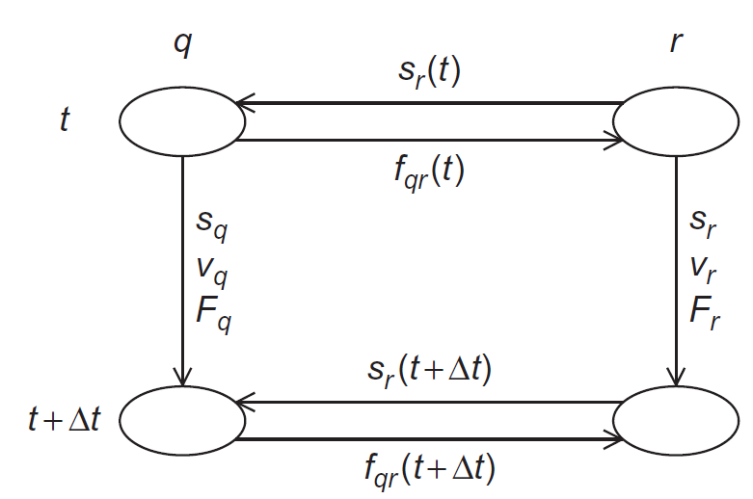
Communications Among Agglomerated Tasks in the Reduced N-Body Solver
q < r
Copyright © 2010, Elsevier Inc. All rights Reserved

Slide 19
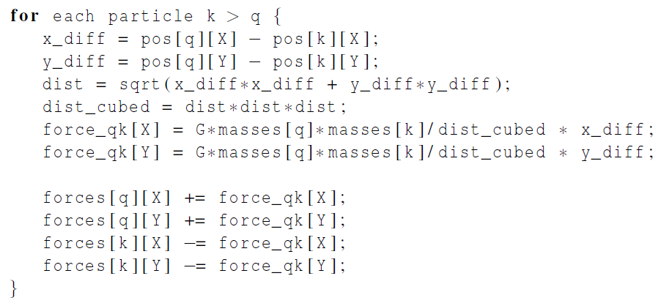
Computing the total force on particle q in the reduced algorithm
Copyright © 2010, Elsevier Inc. All rights Reserved

Slide 20
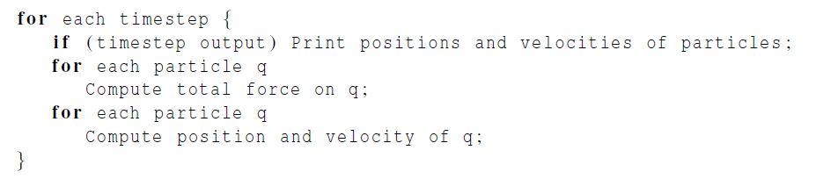
Serial pseudo-code
iterating over particles
In principle, parallelizing the two inner
for loops will map tasks/particles to cores.
Copyright © 2010, Elsevier Inc. All rights Reserved

Slide 21
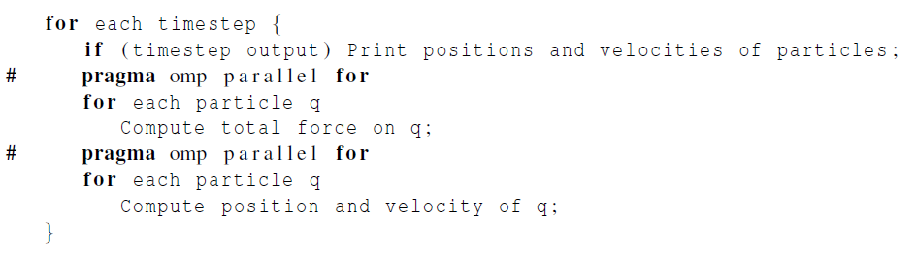
First attempt
Let’s check for race conditions caused by loop-carried dependences.
Copyright © 2010, Elsevier Inc. All rights Reserved

Slide 22
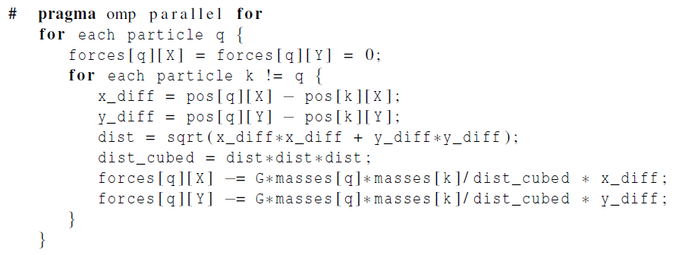
First loop
Copyright © 2010, Elsevier Inc. All rights Reserved

Slide 23
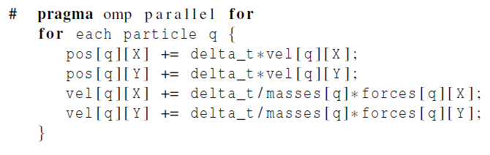
Second loop
Copyright © 2010, Elsevier Inc. All rights Reserved

Slide 24
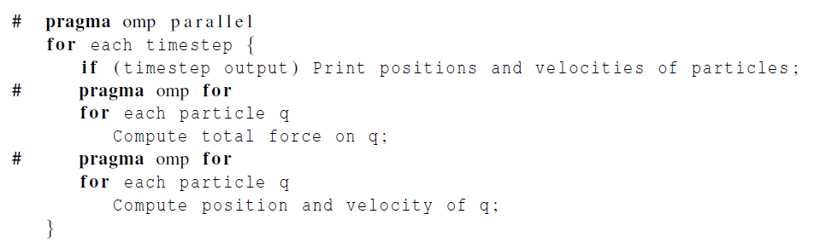
Repeated forking and joining of threads
The same team of threads will be used
in both loops and for every iteration
of the outer loop.
But every thread will print all the
positions and velocities.
Copyright © 2010, Elsevier Inc. All rights Reserved

Slide 25
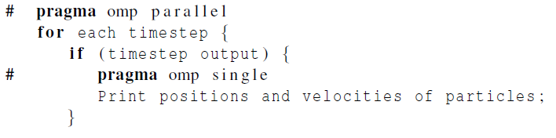
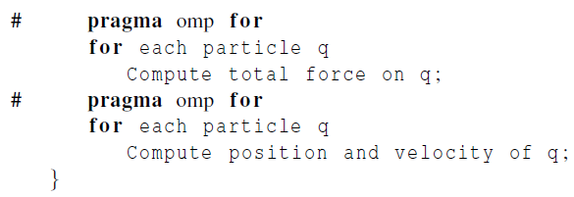
Adding the single directive
Copyright © 2010, Elsevier Inc. All rights Reserved

Slide 26
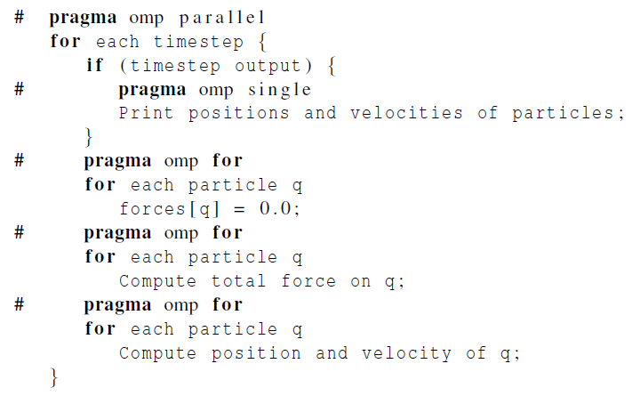
Parallelizing the Reduced Solver Using OpenMP
Copyright © 2010, Elsevier Inc. All rights Reserved

Slide 27


Problems
Updates to forces[3] create a race condition.
In fact, this is the case in general.
Updates to the elements of the forces
array introduce race conditions into the code.
Copyright © 2010, Elsevier Inc. All rights Reserved

Slide 28
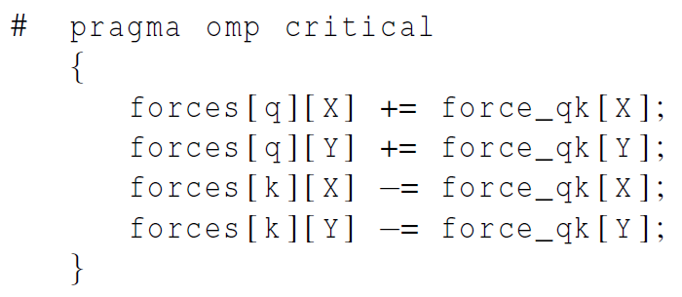
First solution attempt
before all the updates to forces
Access to the forces array will be effectively serialized!!!
Copyright © 2010, Elsevier Inc. All rights Reserved

Slide 29
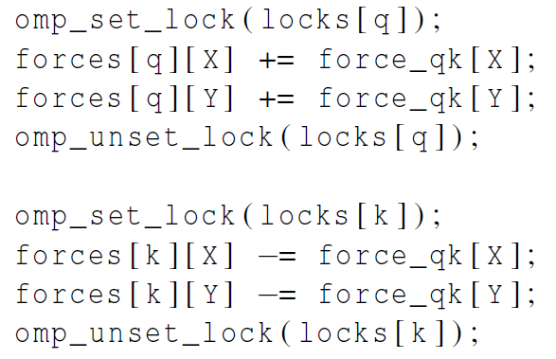
Second solution attempt
Use one lock for each particle.
Copyright © 2010, Elsevier Inc. All rights Reserved

Slide 30
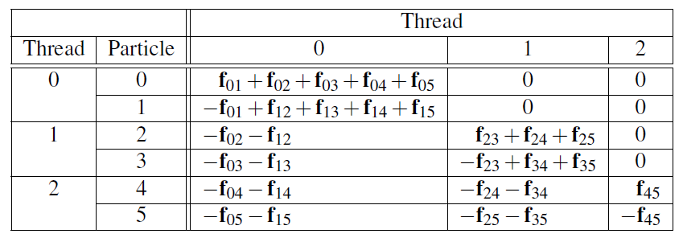
First Phase Computations for Reduced Algorithm with Block Partition
Copyright © 2010, Elsevier Inc. All rights Reserved

Slide 31
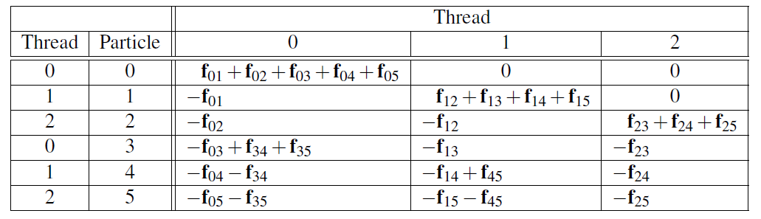
First Phase Computations for Reduced Algorithm with Cyclic Partition
Copyright © 2010, Elsevier Inc. All rights Reserved

Slide 32
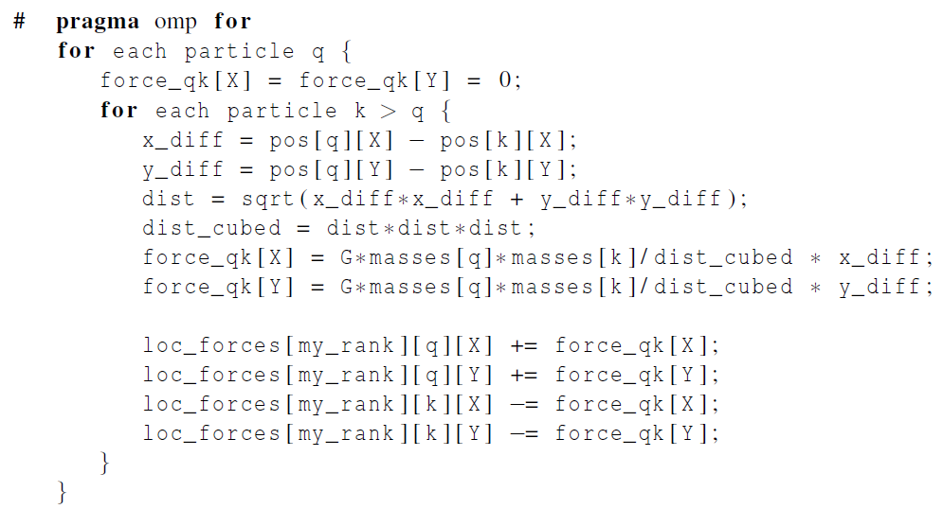
Revised algorithm – phase I
Copyright © 2010, Elsevier Inc. All rights Reserved

Slide 33
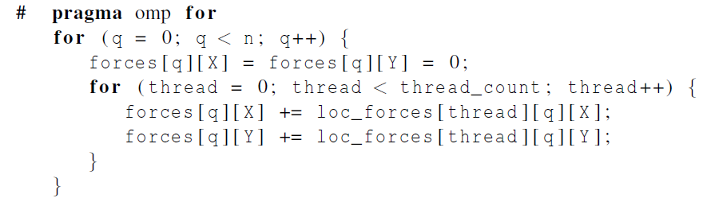
Revised algorithm – phase II
Copyright © 2010, Elsevier Inc. All rights Reserved

Slide 34
Parallelizing the Solvers Using Pthreads
By default local variables in Pthreads are private. So all shared variables are global in the Pthreads version.
The principle data structures in the Pthreads version are identical to those in the OpenMP version: vectors are two-dimensional arrays of doubles, and the mass, position, and velocity of a single particle are stored in a struct.
The forces are stored in an array of vectors.
Copyright © 2010, Elsevier Inc. All rights Reserved

Slide 35
Parallelizing the Solvers Using Pthreads
Startup for Pthreads is basically the same as the startup for OpenMP: the main thread gets the command line arguments, and allocates and initializes the principle data structures.
The main difference between the Pthreads and the OpenMP implementations is in the details of parallelizing the inner loops.
Since Pthreads has nothing analogous to a parallel for directive, we must explicitly determine which values of the loop variables correspond to each thread’s calculations.
Copyright © 2010, Elsevier Inc. All rights Reserved

Slide 36
Parallelizing the Solvers Using Pthreads
Another difference between the Pthreads and the OpenMP versions has to do with barriers.
At the end of a parallel for OpenMP has an implied barrier.
We need to add explicit barriers after the inner loops when a race condition can arise.
The Pthreads standard includes a barrier.
However, some systems don’t implement it.
If a barrier isn't defined we must define a function that uses a Pthreads condition variable to implement a barrier.
Copyright © 2010, Elsevier Inc. All rights Reserved

Slide 37
Parallelizing the Basic Solver Using MPI
Choices with respect to the data structures:
  Each process stores the entire global array of particle masses.
  Each process only uses a single n-element array for the positions.
  Each process uses a pointer loc_pos that refers to the start of its block of pos.
  So on process 0 local_pos = pos; on process 1 local_pos = pos + loc_n; etc.
Copyright © 2010, Elsevier Inc. All rights Reserved

Slide 38
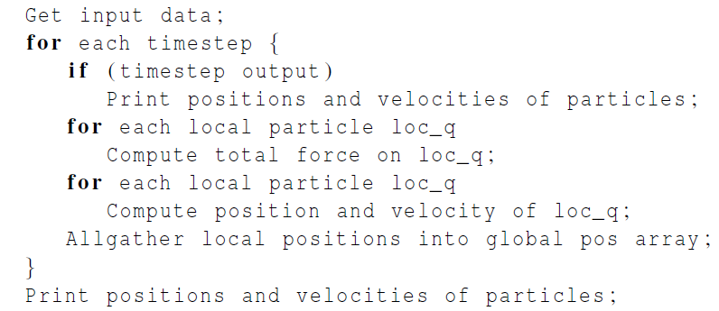
Pseudo-code for the MPI version of the basic n-body solver
Copyright © 2010, Elsevier Inc. All rights Reserved

Slide 39
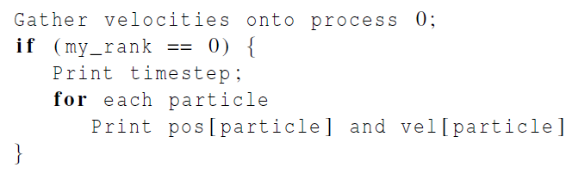

Pseudo-code for output
Copyright © 2010, Elsevier Inc. All rights Reserved

Slide 40
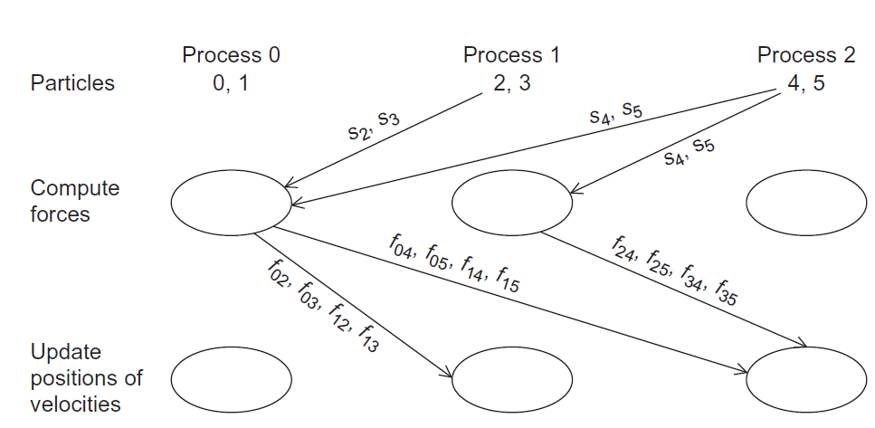
Communication In A Possible MPI Implementation of the N-Body Solver
(for a reduced solver)
Copyright © 2010, Elsevier Inc. All rights Reserved

Slide 41
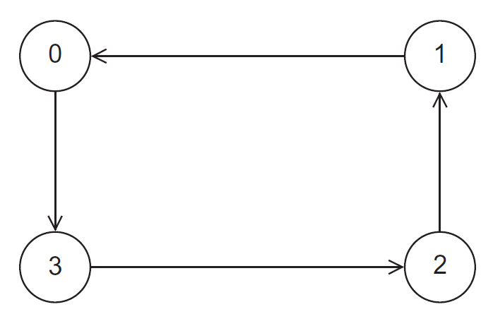
A Ring of Processes
Copyright © 2010, Elsevier Inc. All rights Reserved

Slide 42
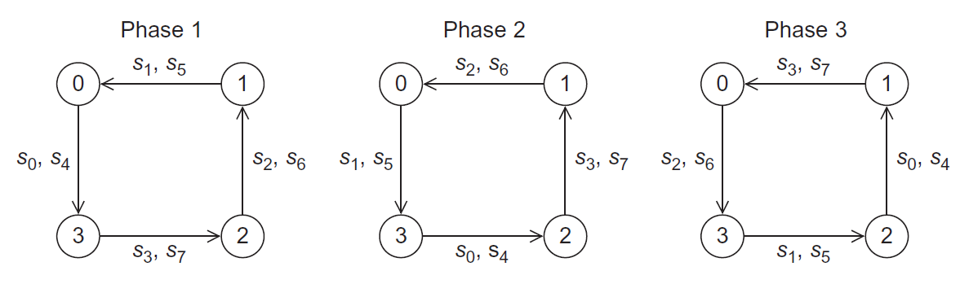
Ring Pass of Positions
Copyright © 2010, Elsevier Inc. All rights Reserved

Slide 43
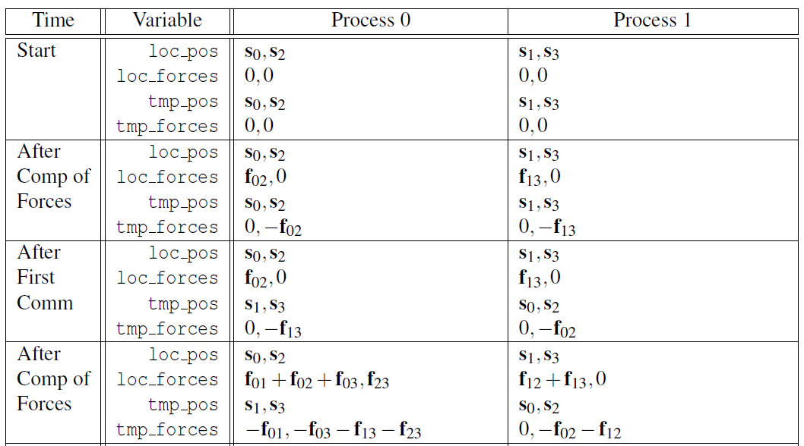
Computation of Forces in Ring Pass (1)
Copyright © 2010, Elsevier Inc. All rights Reserved

Slide 44
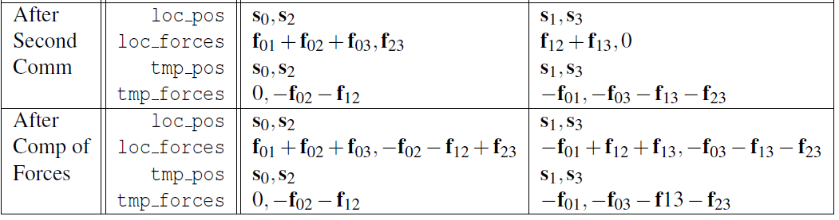
Computation of Forces in Ring Pass (2)
Copyright © 2010, Elsevier Inc. All rights Reserved

Slide 45
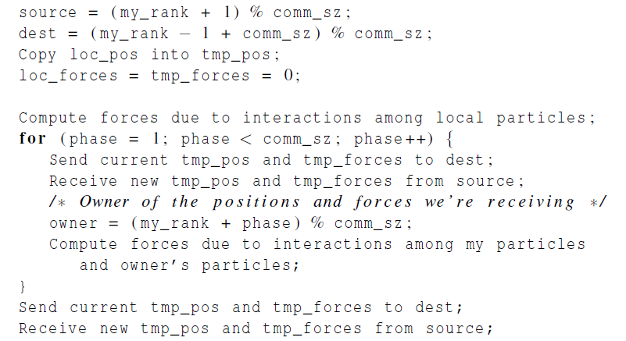
Pseudo-code for the MPI implementation of the reduced n-body solver
Copyright © 2010, Elsevier Inc. All rights Reserved

Slide 46
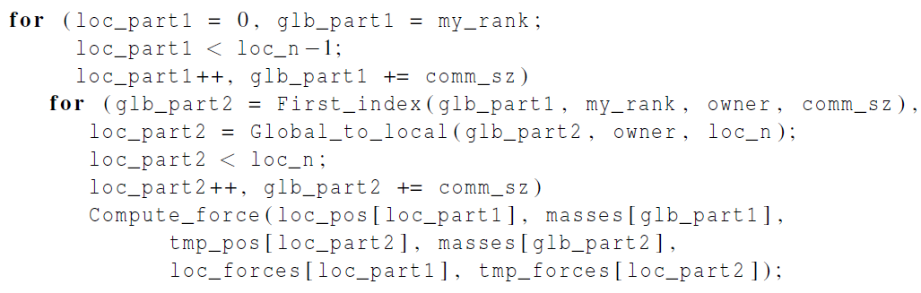
Loops iterating through global particle indexes
Copyright © 2010, Elsevier Inc. All rights Reserved

Slide 47
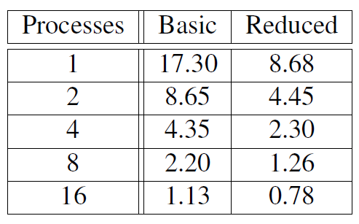
Performance of the MPI n-body solvers
(in seconds)
Copyright © 2010, Elsevier Inc. All rights Reserved

Slide 48
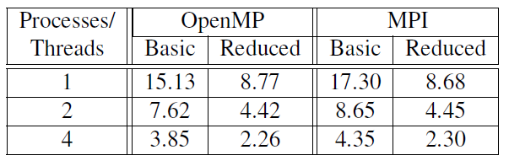
Run-Times for OpenMP and MPI N-Body Solvers
(in seconds)
Copyright © 2010, Elsevier Inc. All rights Reserved

Slide 49

TREE SEARCH
Copyright © 2010, Elsevier Inc. All rights Reserved

Slide 50
Tree search problem (TSP)
An NP-complete problem.
No known solution to TSP that is better in all cases than exhaustive search.
Ex., the travelling salesperson problem, finding a minimum cost tour.
Copyright © 2010, Elsevier Inc. All rights Reserved

Slide 51
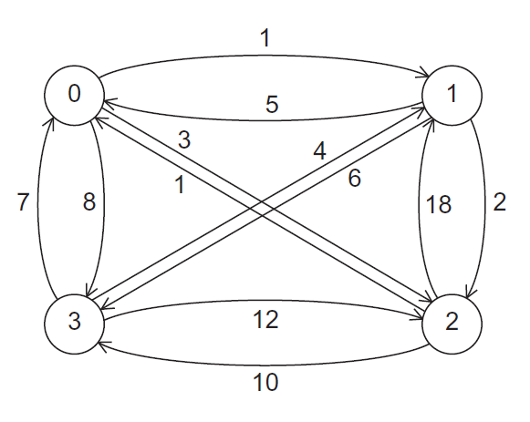

A Four-City TSP
Copyright © 2010, Elsevier Inc. All rights Reserved

Slide 52
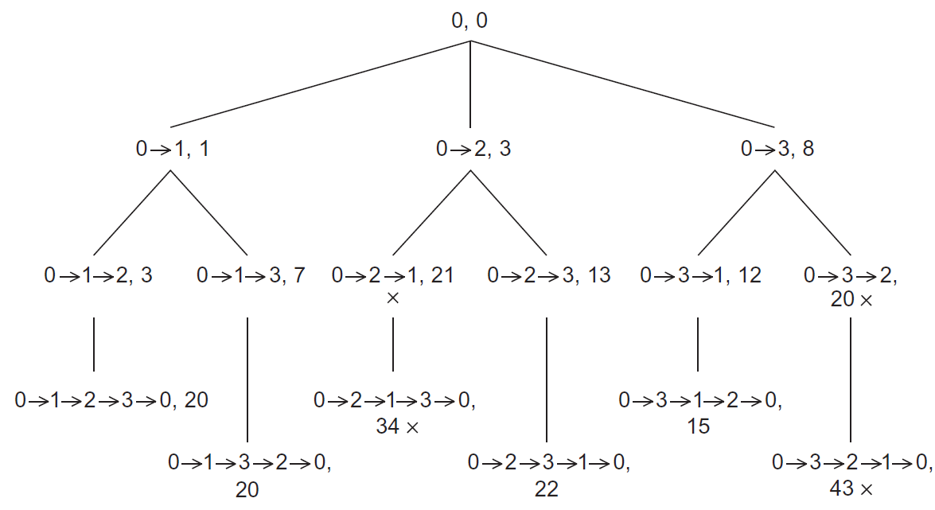
Search Tree for Four-City TSP
Copyright © 2010, Elsevier Inc. All rights Reserved

Slide 53
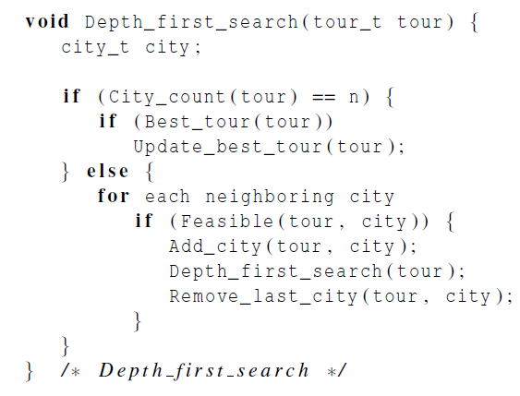
Pseudo-code for a recursive solution to TSP using depth-first search
Copyright © 2010, Elsevier Inc. All rights Reserved

Slide 54
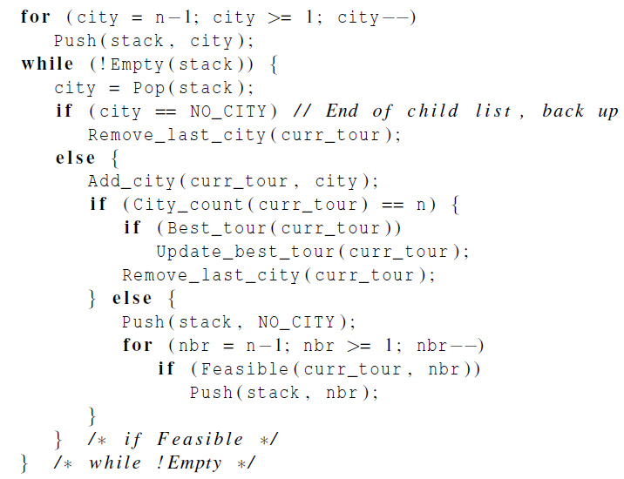
Pseudo-code for an implementation of a depth-first solution to TSP without recursion
Copyright © 2010, Elsevier Inc. All rights Reserved

Slide 55
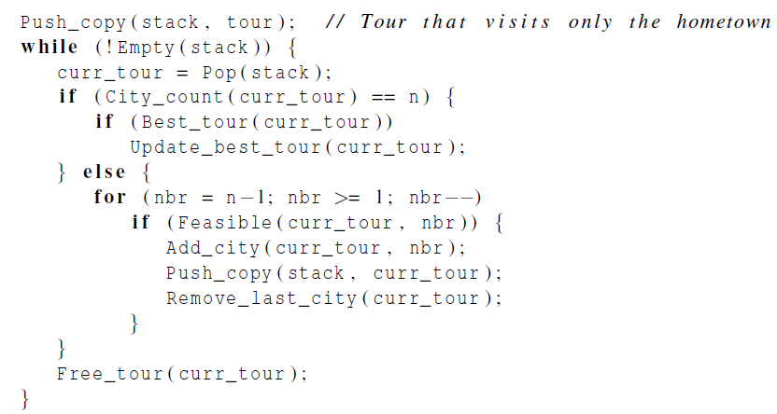
Pseudo-code for a second solution to TSP that doesn’t use recursion
Copyright © 2010, Elsevier Inc. All rights Reserved

Slide 56
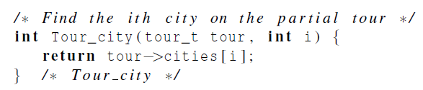

Using pre-processor macros
Copyright © 2010, Elsevier Inc. All rights Reserved

Slide 57
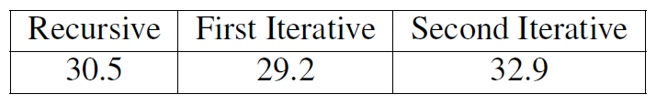

Run-Times of the Three Serial Implementations of Tree Search
(in seconds)
The digraph contains 15 cities.
All three versions visited approximately 95,000,000 tree nodes.
Copyright © 2010, Elsevier Inc. All rights Reserved

Slide 58
Making sure we have the “best tour” (1)
When a process finishes a tour, it needs to check if it has a better solution than recorded so far.
The global Best_tour function only reads the global best cost, so we don’t need to tie it up by locking it. There’s no contention with other readers.
If the process does not have a better solution, then it does not attempt an update.
Copyright © 2010, Elsevier Inc. All rights Reserved

Slide 59
Making sure we have the “best tour” (2)
If another thread is updating while we read, we may see the old value or the new value.
The new value is preferable, but to ensure this would be more costly than it is worth.
Copyright © 2010, Elsevier Inc. All rights Reserved

Slide 60
Making sure we have the “best tour” (3)
In the case where a thread tests and decides it has a better global solution, we need to ensure two things:
  1) That the process locks the value with a mutex, preventing a race condition.
  2) In the possible event that the first check was against an old value while another process was updating, we do not put a worse value than the new one that was being written.
We handle this by locking, then testing again.
Copyright © 2010, Elsevier Inc. All rights Reserved

Slide 61
First scenario
global
tour value
process y
process x
local
tour value
local
tour value
30
27
22
22
27
3. test
1. test
6. lock
2. lock
7. test again
4. update
8. update
5. unlock
9. unlock
Copyright © 2010, Elsevier Inc. All rights Reserved

Slide 62
Second scenario
global
tour value
process y
process x
local
tour value
local
tour value
30
27
29
27
3. test
1. test
6. lock
2. lock
7. test again
4. update
8. unlock
5. unlock
Copyright © 2010, Elsevier Inc. All rights Reserved

Slide 63
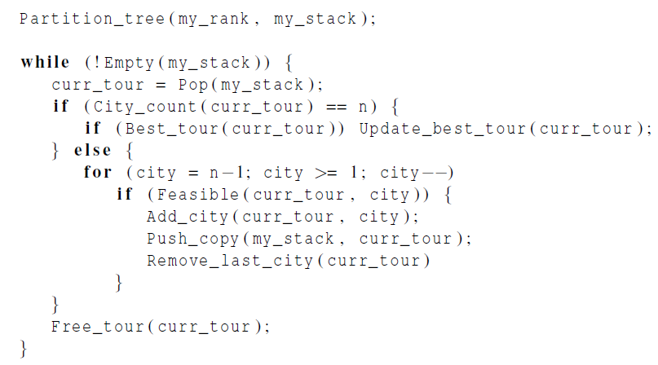
Pseudo-code for a Pthreads implementation of a statically parallelized solution to TSP
Copyright © 2010, Elsevier Inc. All rights Reserved

Slide 64
Dynamic Parallelization of Tree Search Using Pthreads
Termination issues.
Code executed by a thread before it splits:
  It checks that it has at least two tours in its stack.
  It checks that there are threads waiting.
  It checks whether the new_stack variable is NULL.
Copyright © 2010, Elsevier Inc. All rights Reserved

Slide 65
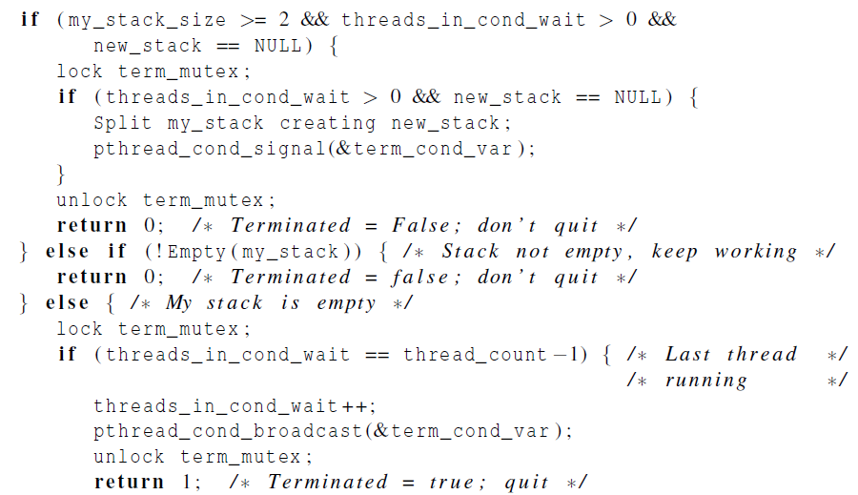
Pseudo-Code for Pthreads Terminated Function (1)
Copyright © 2010, Elsevier Inc. All rights Reserved

Slide 66
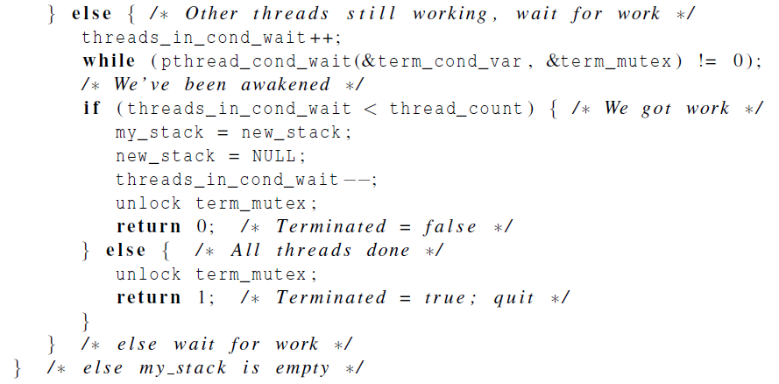
Pseudo-Code for Pthreads Terminated Function (2)
Copyright © 2010, Elsevier Inc. All rights Reserved

Slide 67
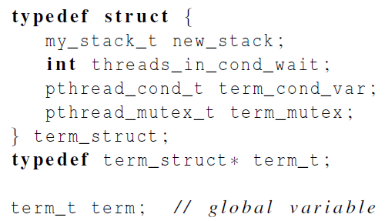
Grouping the termination variables
Copyright © 2010, Elsevier Inc. All rights Reserved

Slide 68
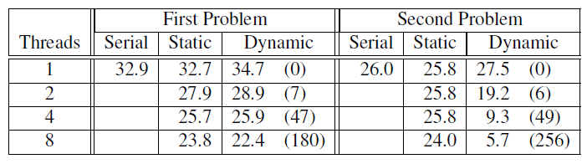
Run-times of Pthreads tree search programs
15-city problems
(in seconds)
numbers of times
stacks were split
Copyright © 2010, Elsevier Inc. All rights Reserved

Slide 69


Parallelizing the Tree Search Programs Using OpenMP
Same basic issues implementing the static and dynamic parallel tree search programs as Pthreads.
A few small changes can be noted.
Pthreads
OpenMP
Copyright © 2010, Elsevier Inc. All rights Reserved

Slide 70

OpenMP emulated condition wait
Copyright © 2010, Elsevier Inc. All rights Reserved

Slide 71

Performance of OpenMP and Pthreads implementations of tree search
(in seconds)
Copyright © 2010, Elsevier Inc. All rights Reserved

Slide 72

IMPLEMENTATION OF TREE SEARCH USING MPI AND STATIC PARTITIONING
Copyright © 2010, Elsevier Inc. All rights Reserved

Slide 73

Sending a different number of objects to each process in the communicator
Copyright © 2010, Elsevier Inc. All rights Reserved

Slide 74

Gathering a different number of objects from each process in the communicator
Copyright © 2010, Elsevier Inc. All rights Reserved

Slide 75


Checking to see if a message is available
Copyright © 2010, Elsevier Inc. All rights Reserved

Slide 76

Terminated Function for a Dynamically Partitioned TSP solver that Uses MPI.
Copyright © 2010, Elsevier Inc. All rights Reserved

Slide 77
Modes and Buffered Sends
MPI provides four modes for sends.
  Standard
  Synchronous
  Ready
  Buffered
Copyright © 2010, Elsevier Inc. All rights Reserved

Slide 78


Printing the best tour
Copyright © 2010, Elsevier Inc. All rights Reserved

Slide 79

Terminated Function for a Dynamically Partitioned TSP solver with MPI (1)
Copyright © 2010, Elsevier Inc. All rights Reserved

Slide 80

Terminated Function for a Dynamically Partitioned TSP solver with MPI (2)
Copyright © 2010, Elsevier Inc. All rights Reserved

Slide 81


Packing data into a buffer of contiguous memory
Copyright © 2010, Elsevier Inc. All rights Reserved

Slide 82


Unpacking data from a buffer of contiguous memory
Copyright © 2010, Elsevier Inc. All rights Reserved

Slide 83

Copyright © 2010, Elsevier Inc. All rights Reserved

Slide 84

Performance of MPI and Pthreads implementations of tree search
(in seconds)
Copyright © 2010, Elsevier Inc. All rights Reserved

Slide 85
Concluding Remarks (1)
In developing the reduced MPI solution to the n-body problem, the “ring pass” algorithm proved to be much easier to implement and is probably more scalable.
In a distributed memory environment in which processes send each other work, determining when to terminate is a nontrivial problem.
Copyright © 2010, Elsevier Inc. All rights Reserved

Slide 86
Concluding Remarks (2)
When deciding which API to use, we should consider whether to use shared- or distributed-memory.
We should look at the memory requirements of the application and the amount of communication among the processes/threads.
Copyright © 2010, Elsevier Inc. All rights Reserved

Slide 87
Concluding Remarks (3)
If the memory requirements are great or the distributed memory version can work mainly with cache, then a distributed memory program is likely to be much faster.
On the other hand if there is considerable communication, a shared memory program will probably be faster.
Copyright © 2010, Elsevier Inc. All rights Reserved

Slide 88
Concluding Remarks (3)
In choosing between OpenMP and Pthreads, if there’s an existing serial program and it can be parallelized by the insertion of OpenMP directives, then OpenMP is probably the clear choice.
However, if complex thread synchronization is needed then Pthreads will be easier to use.
Copyright © 2010, Elsevier Inc. All rights Reserved

